Slide 1
Electric-filed mapped averaging
For dielectric constant
Weisong Lin

Slide 2

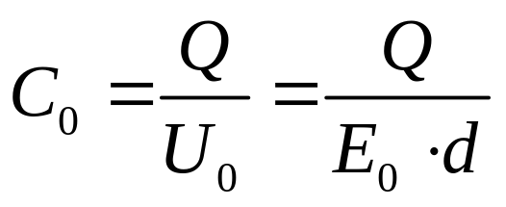
Introduction
What is dielectric constant?
Definition from Wikipedia: The relative permittivity of a material is its dielectric permittivity expressed as a ratio relative to the permittivity of vacuum.
How to measure it?
+Q
+
+
+
+
+
+
+
+
+
+
+
+
+
+
d
-
-
-
-
-
-
-
-
-
-
-
-
-
-
-Q
Vacuum

Slide 3
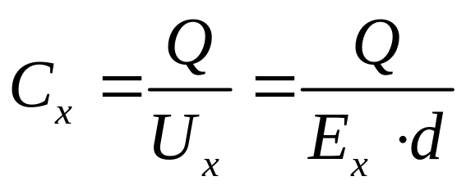
Introduction
What is dielectric constant?
Definition from Wikipedia: The relative permittivity of a material is its dielectric permittivity expressed as a ratio relative to the permittivity of vacuum.
How to measure it?
+Q
+
+
+
+
+
+
+
+
+
+
+
+
+
+
d
-
-
-
-
-
-
-
-
-
-
-
-
-
-
-Q
Dielectric

Slide 4
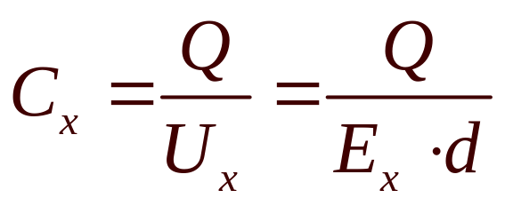
Introduction
What is dielectric constant?
Definition from Wikipedia: The relative permittivity of a material is its dielectric permittivity expressed as a ratio relative to the permittivity of vacuum.
How to measure it?
+Q
+
+
+
+
+
+
+
+
+
+
+
+
+
+
-
-
-
-
-
-
-
+
+
+
+
+
+
+
-
-
-
-
-
-
-
-
-
-
-
-
-
-
-Q
Dielectric

Slide 5

polarization
1. Basic atomic model
2. Dipole polarization
H⁺
-
+
O⁻
M
M
H⁺
E
3. Ionic polarization
Cl⁻
Cl⁻
Na⁺
Cl⁻
Cl⁻

Slide 6



Method
Free-energy perturbation
Find free energy difference by averaging over microstates sampled from ensemble
FEP:
0
1
0
1
Targeted FEP:
0
0`
1

Slide 7







Slide 9


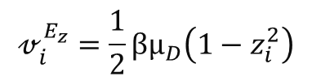
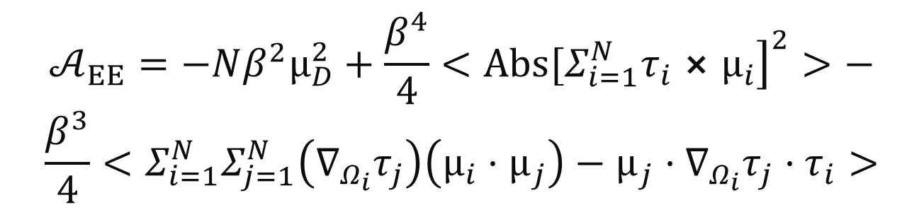
Mapped averaging formulas:
Formulas

Slide 10
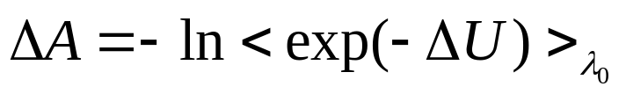

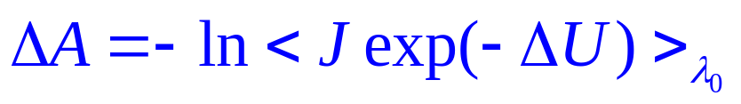
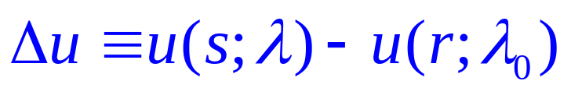

Method
Mapped average
Mapped average improves the Target FEP by coupling to displacement of coordinates.
FEP:
Mapped average:
Introduce mapping :
0
0`
1

Slide 11



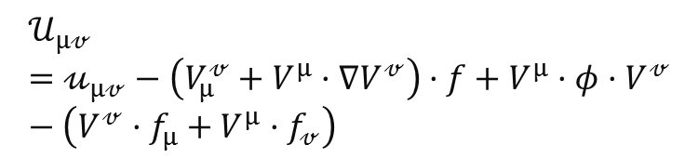


Slide 12
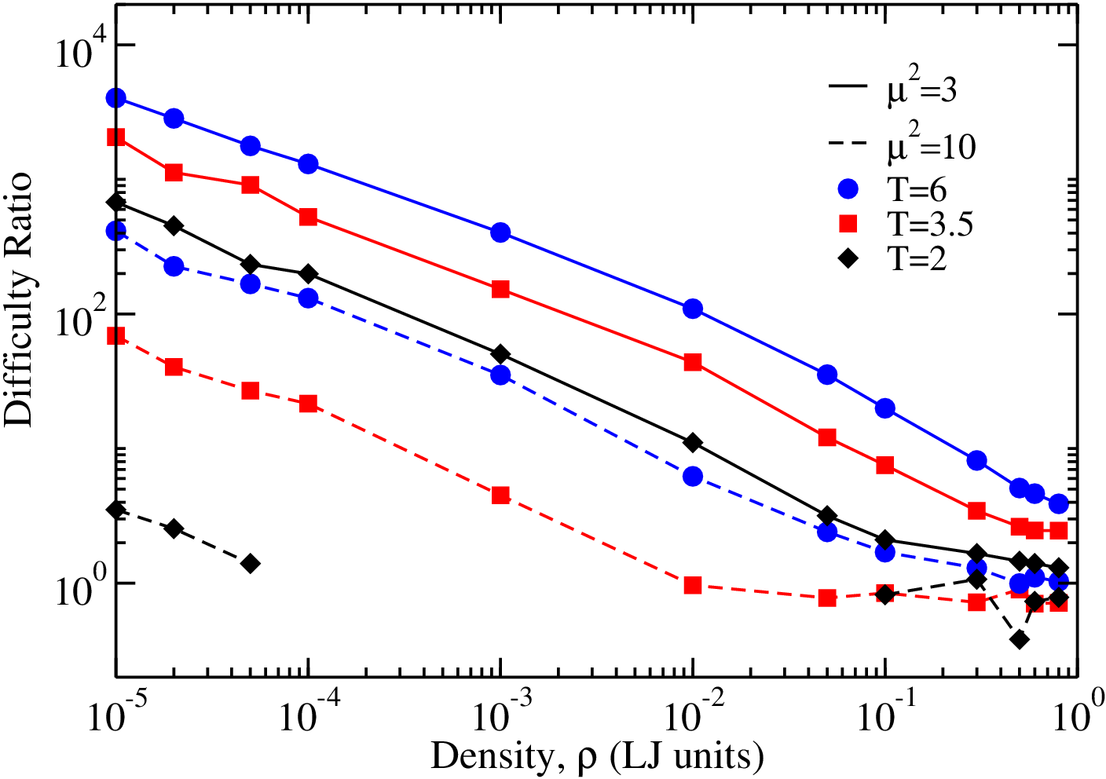
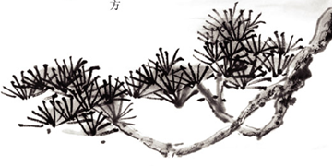
Results StockMeyer

Slide 13
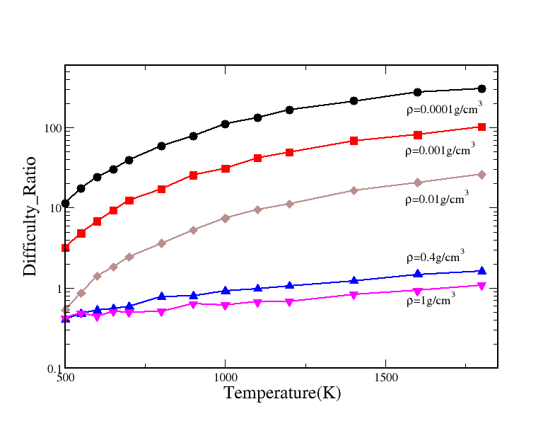

Water Isocal

Slide 14
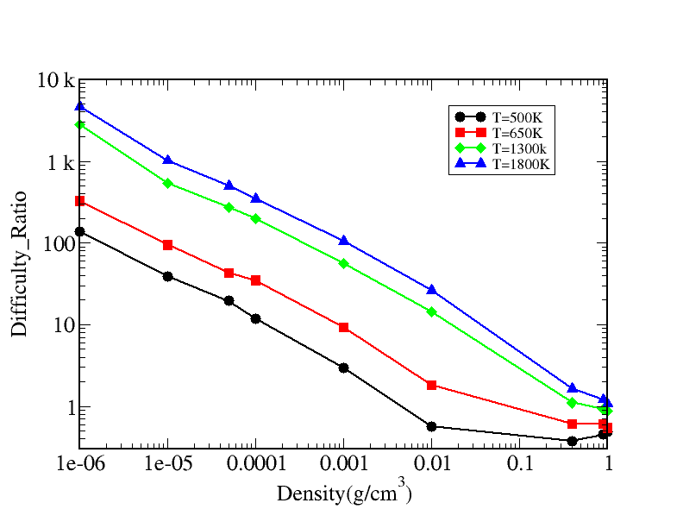
Results isothermal
Comparison of CPU times
Number of molecules:256
Dipole strength: 1
Density: 0.025(simulation unit)

Slide 15
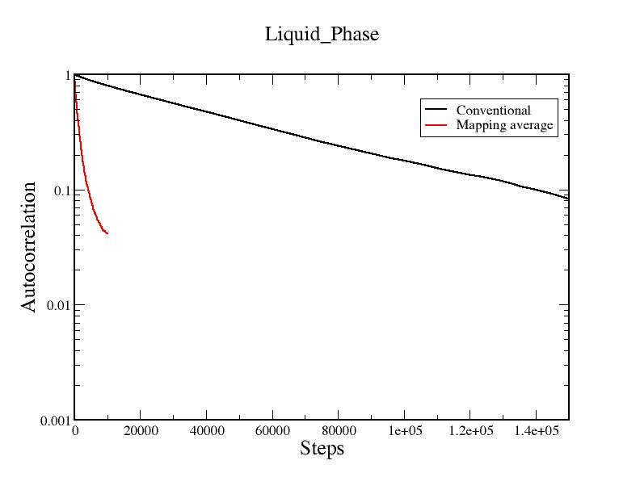
Results Correlation liquid phase
Comparison of CPU times
Number of molecules:256
Dipole strength: 1
Density: 0.025(simulation unit)

Slide 16
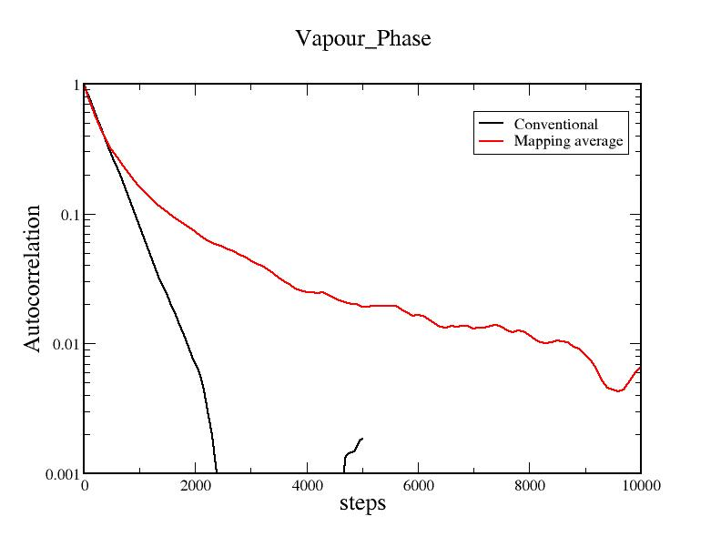
Results correlation gas phase
Comparison of CPU times
Number of molecules:256
Dipole strength: 1
Density: 0.025(simulation unit)

Slide 17
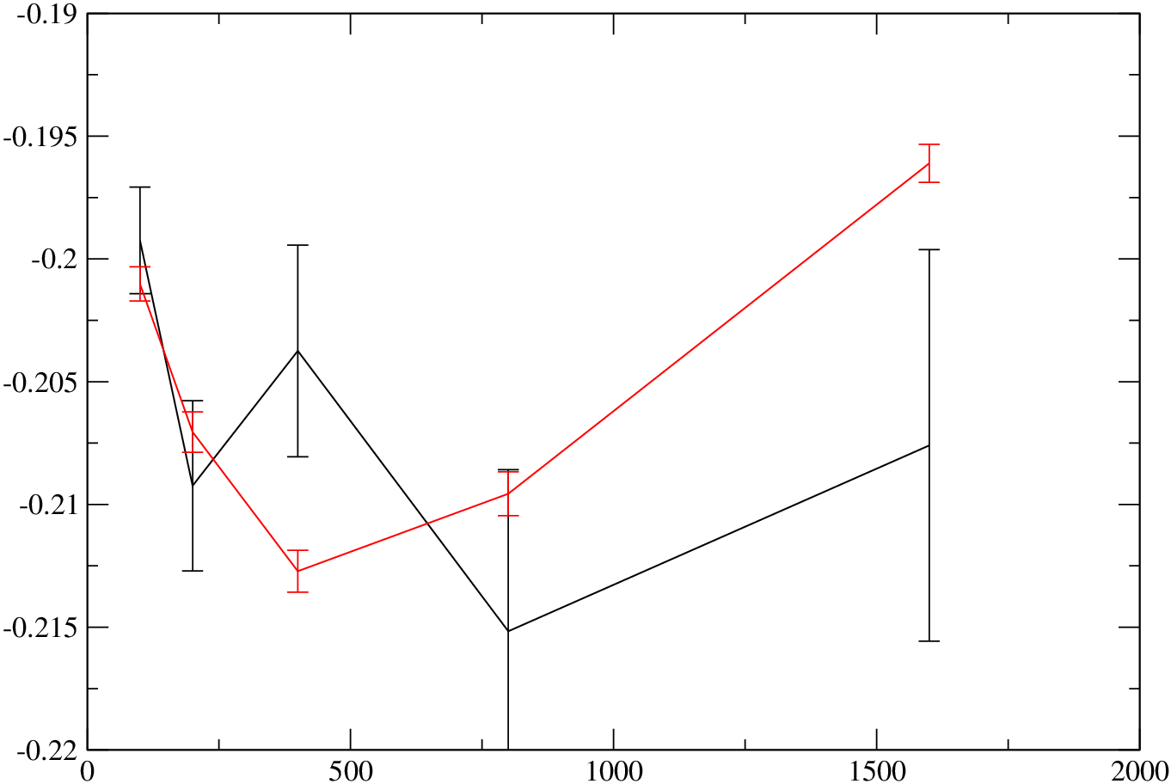
Results SZ-liquid
Comparison of CPU times
Number of molecules:256
Dipole strength: 1
Density: 0.025(simulation unit)

Slide 18
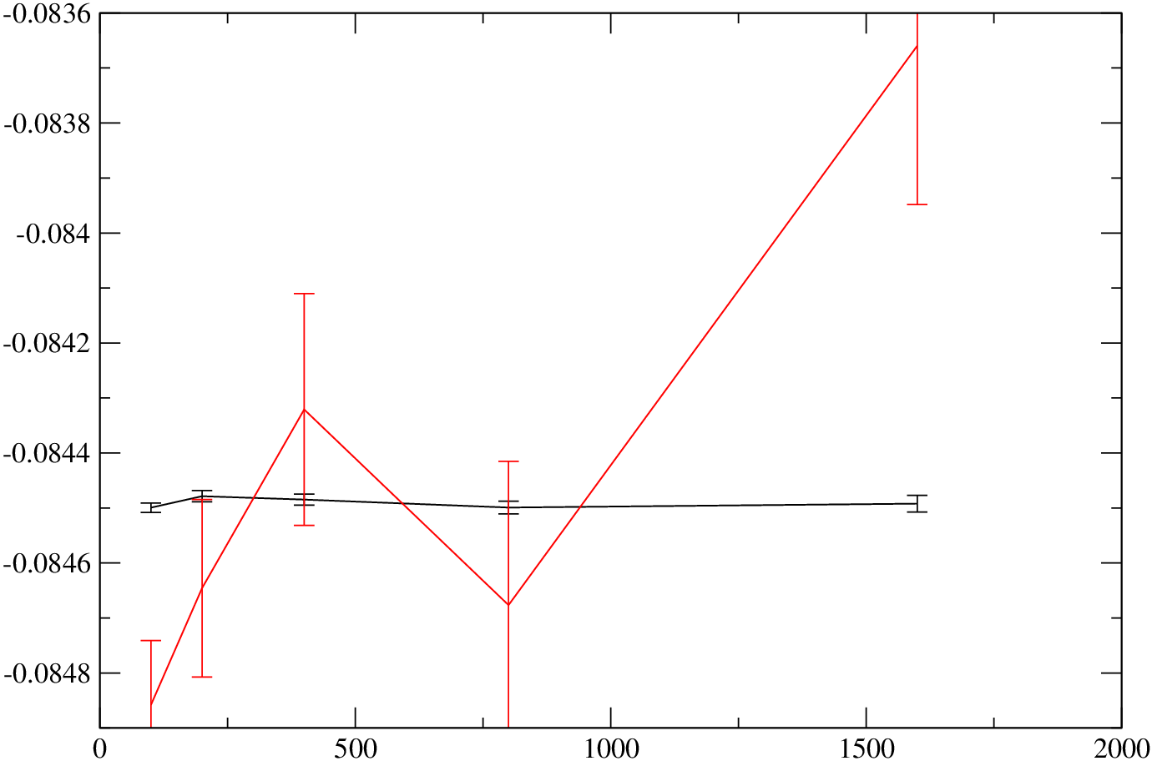
Results SZ_gas_phase
Comparison of CPU times
Number of molecules:256
Dipole strength: 1
Density: 0.025(simulation unit)

Slide 19

Thanks!
PPT模板下载：www.1ppt.com/moban/ 行业PPT模板：www.1ppt.com/hangye/
节日PPT模板：www.1ppt.com/jieri/ PPT素材下载：www.1ppt.com/sucai/
PPT背景图片：www.1ppt.com/beijing/ PPT图表下载：www.1ppt.com/tubiao/
优秀PPT下载：www.1ppt.com/xiazai/ PPT教程： www.1ppt.com/powerpoint/
Word教程： www.1ppt.com/word/ Excel教程：www.1ppt.com/excel/
资料下载：www.1ppt.com/ziliao/ PPT课件下载：www.1ppt.com/kejian/
范文下载：www.1ppt.com/fanwen/ 试卷下载：www.1ppt.com/shiti/
教案下载：www.1ppt.com/jiaoan/

